Slide 1
Introduction to Robotics
CSE 461
Class Topic: Introduction to Control System Theory (PID)
Riad Ahmed
Lecturer
Brac University

Slide 2
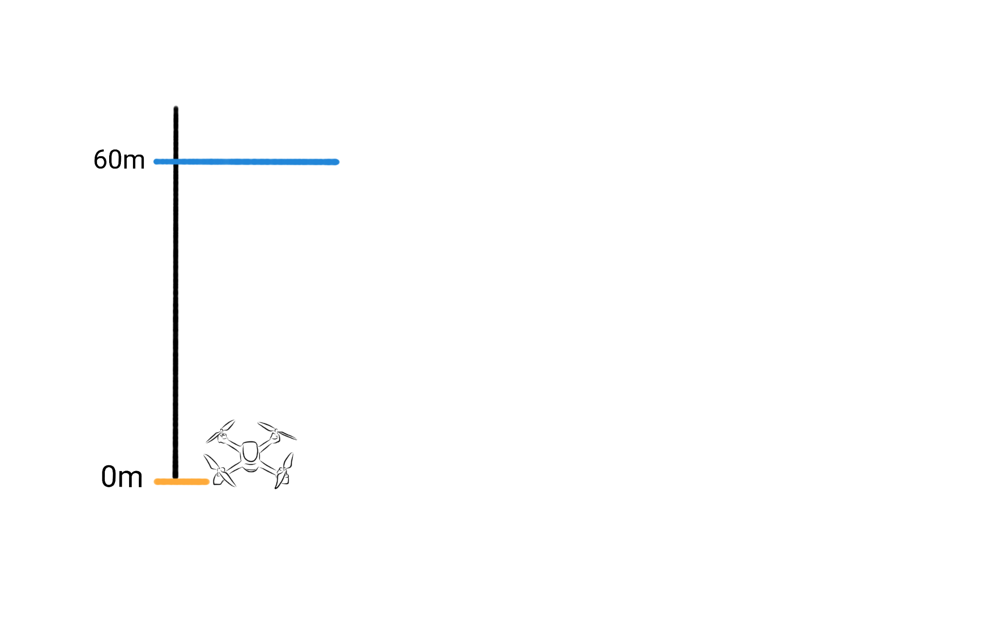

Slide 3
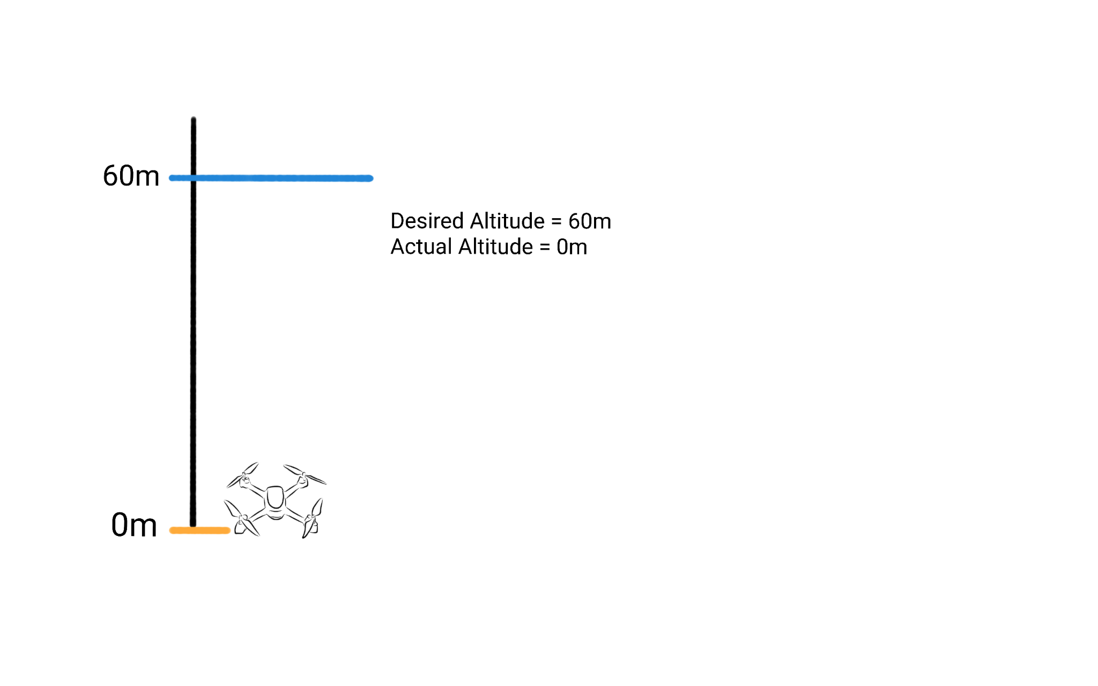

Slide 4
Desired Altitude - Actual Altitude
= 60m - 0m
= 60

Slide 5
Desired Altitude - Actual Altitude
= 60m - 0m
= 60
= Error

Slide 6
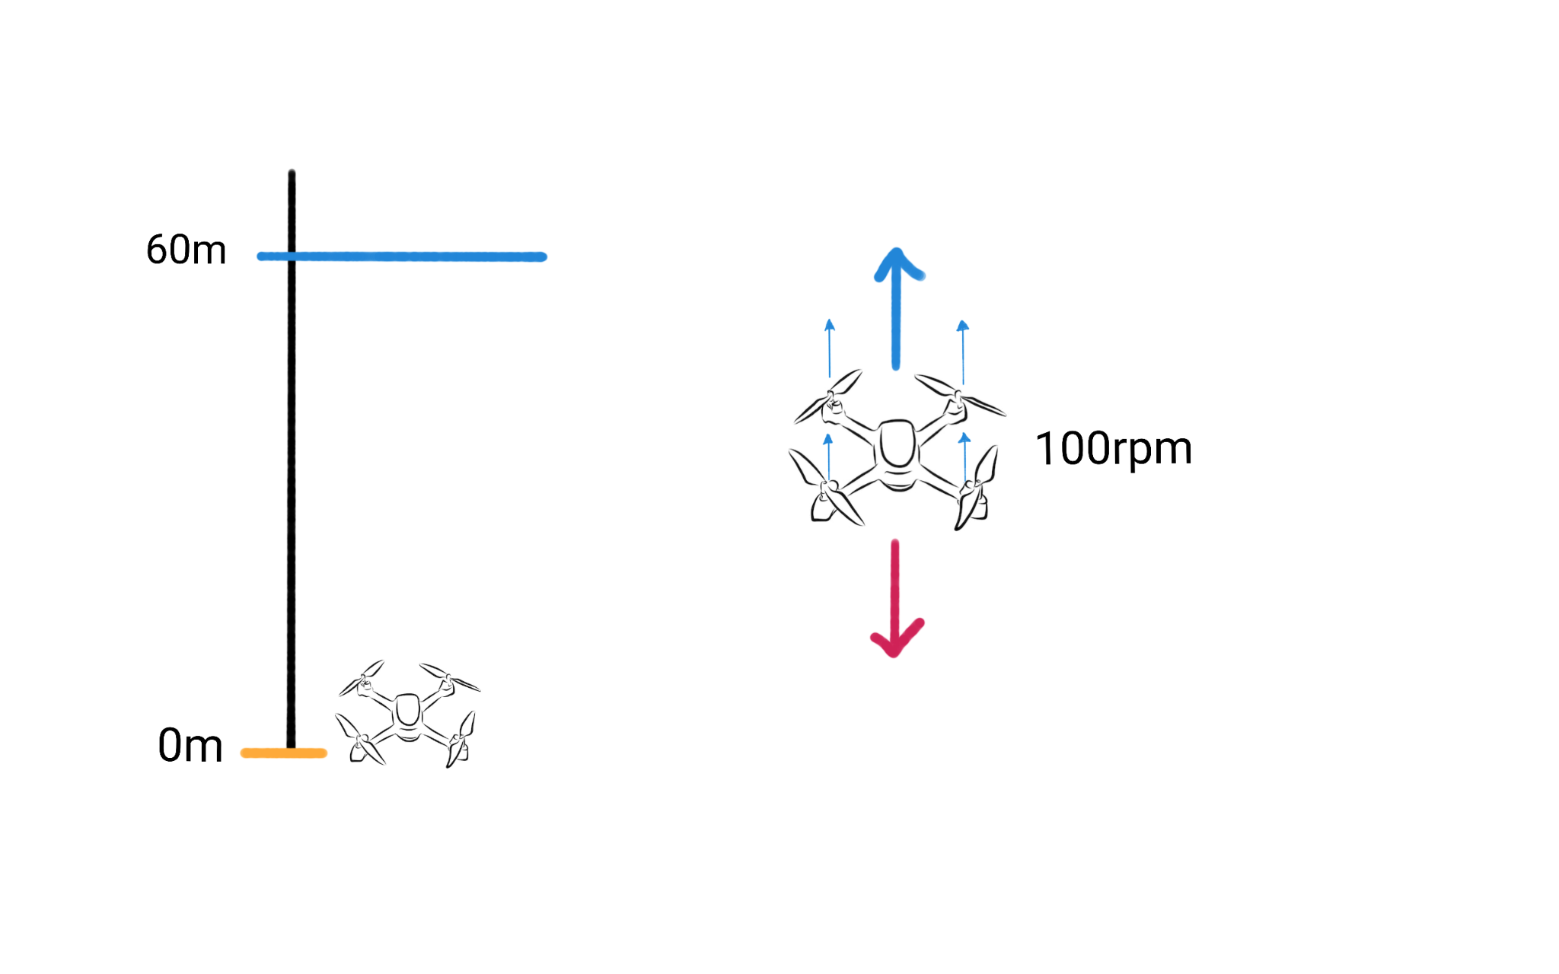

Slide 7
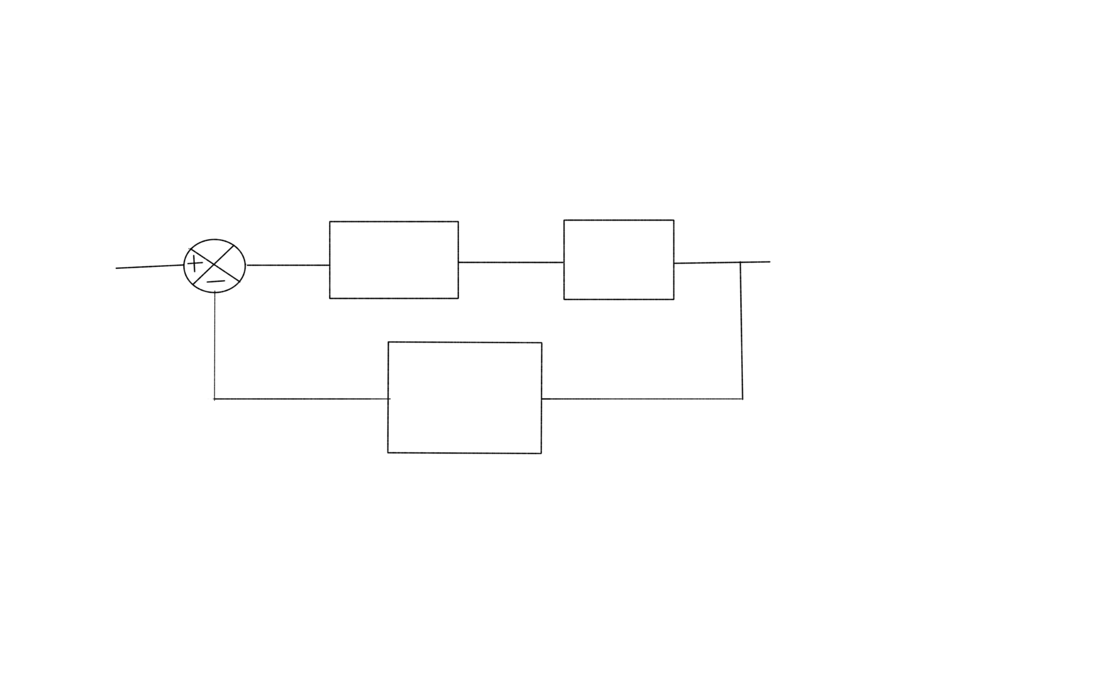
Desired Altitude
Gain
Propeller
Actual Altitude
Altitude Measuring Sensor

Slide 8
Desired Altitude
1
Propeller
Actual Altitude
Altitude Measuring Sensor

Slide 9
Desired Altitude
1
Propeller
Actual Altitude
Altitude Measuring Sensor
Desired Altitude - Actual Altitude
= 60m - 0m
= 60
Propeller Speed = 60 * 1 = 60 rpm

Slide 10
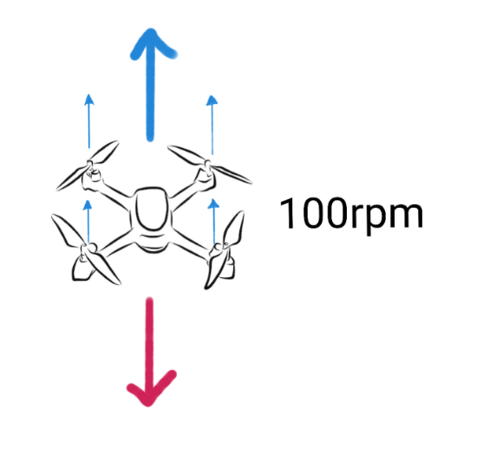
Desired Altitude
1
Propeller
Actual Altitude
Altitude Measuring Sensor
Desired Altitude - Actual Altitude
= 60m - 0m
= 60
Propeller Speed = 60 * 1 = 60 rpm

Slide 11
Desired Altitude
2
Propeller
Actual Altitude
Altitude Measuring Sensor

Slide 12
Desired Altitude
2
Propeller
Actual Altitude
Altitude Measuring Sensor
Desired Altitude - Actual Altitude
= 60m - 0m
= 60
Propeller Speed = 60 * 2 = 120 rpm

Slide 13
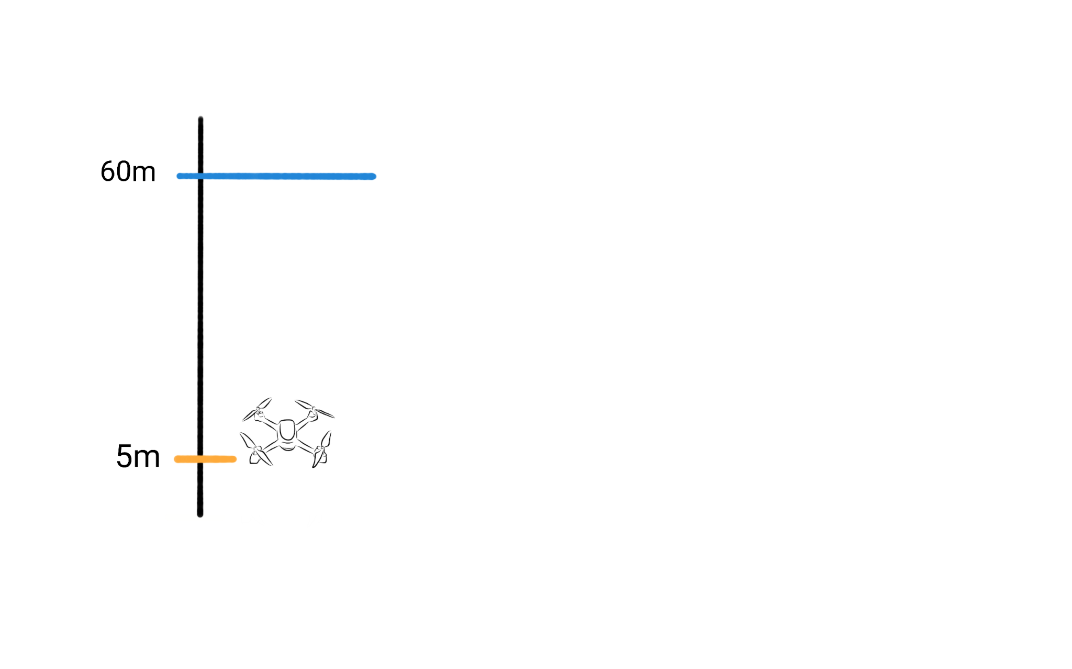
Desired Altitude
2
Propeller
Actual Altitude
Altitude Measuring Sensor
Desired Altitude - Actual Altitude
= 60m - 5m
= 55
Propeller Speed = 55 * 2 = 110 rpm

Slide 14
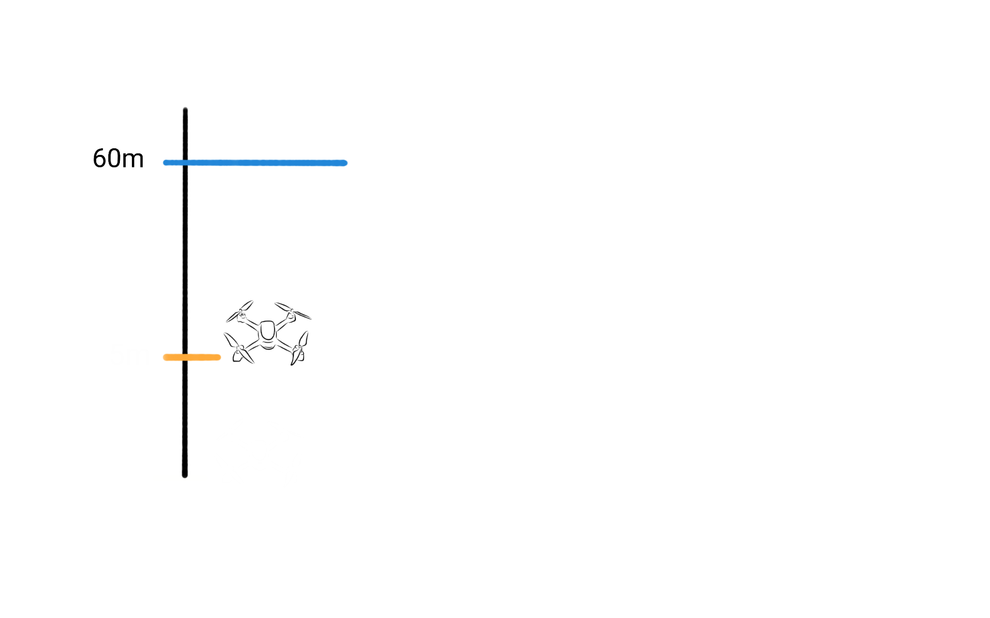
Desired Altitude
2
Propeller
Actual Altitude
Altitude Measuring Sensor
Desired Altitude - Actual Altitude
= 60m - 10m
= 50
Propeller Speed = 50 * 2 = 100 rpm
10m

Slide 15
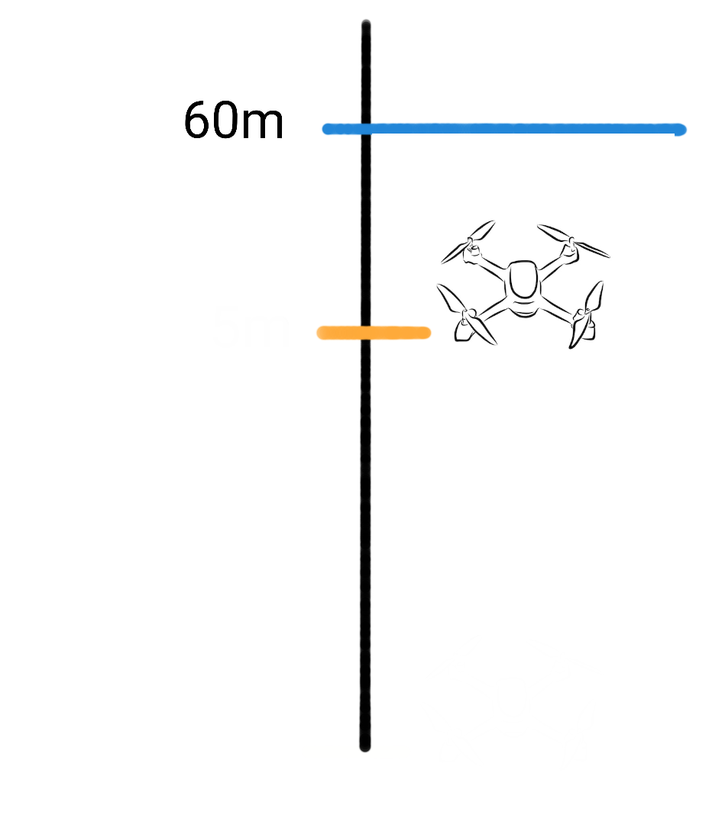
Desired Altitude
10
Propeller
Actual Altitude
Altitude Measuring Sensor
Propeller Speed = 10 * 10 = 100 rpm
Error = 10
50m

Slide 16
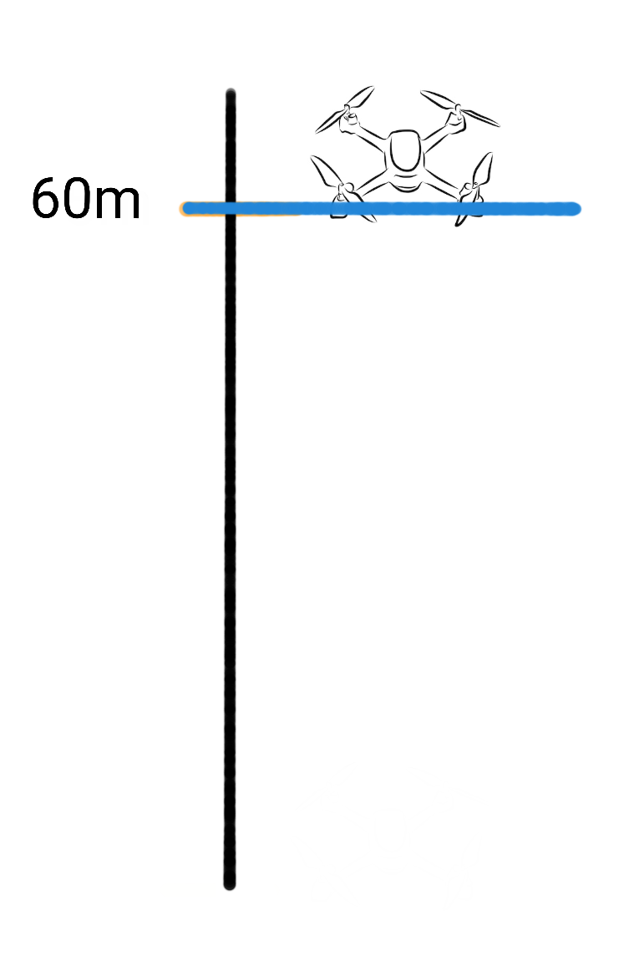
Desired Altitude
10
Propeller
Actual Altitude
Altitude Measuring Sensor

Slide 17
Desired Altitude
10
Propeller
Actual Altitude
Altitude Measuring Sensor
Desired Altitude - Actual Altitude
= 60m - 60m
= 0
Propeller Speed = 0 * 10 = 0 rpm

Slide 18
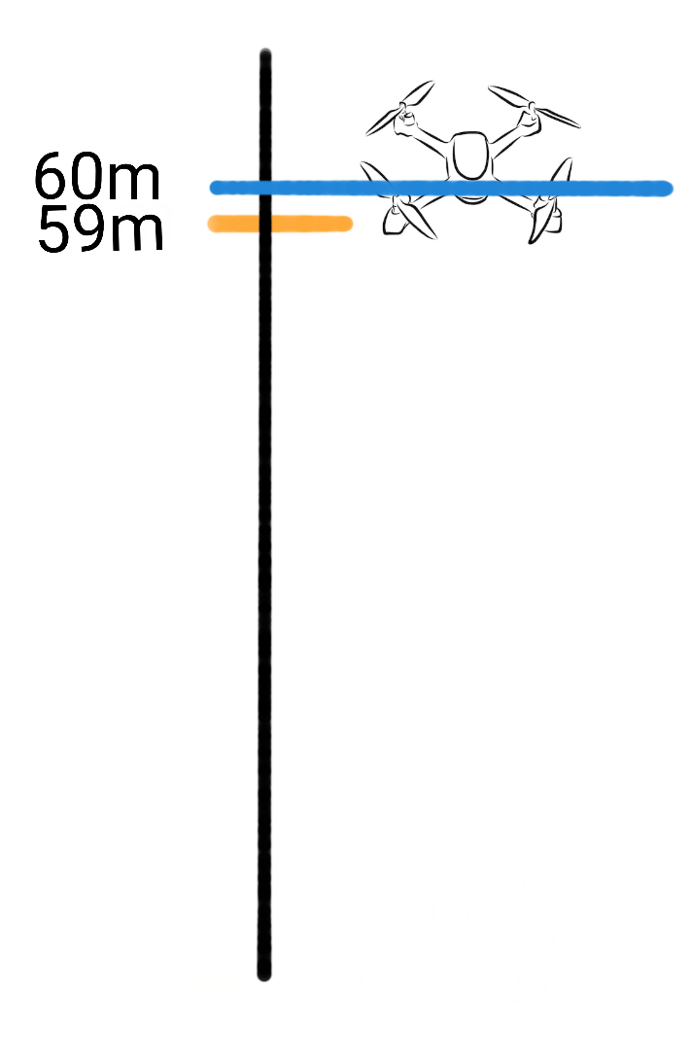
Desired Altitude
100
Propeller
Actual Altitude
Altitude Measuring Sensor
Desired Altitude - Actual Altitude
= 60m - 59m
= 1
Propeller Speed = 1 *100 = 100 rpm

Slide 19
Desired Altitude
10
Propeller
Actual Altitude
Altitude Measuring Sensor
Propeller Speed = 10 * 10 = 100 rpm
Error = 10
50m
Output = Kp * error

Slide 20
Desired Altitude
10
Propeller
Actual Altitude
Altitude Measuring Sensor
Propeller Speed = 10 * 10 = 100 rpm
Error = 10
50m
Output = Kp * error
Proportional Control

Slide 21
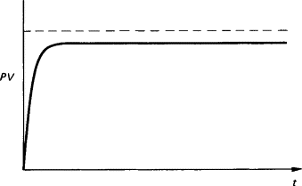
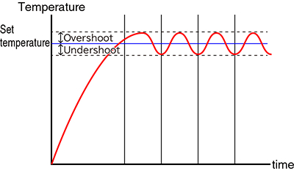
Proportional Control

Slide 22
Desired Altitude
Ki*e + Kp * ∫e
Propeller
Actual Altitude
Altitude Measuring Sensor
Propeller Speed = 10 * 10 = 100 rpm
Error = 10
50m

Slide 23
Desired Altitude
Ki*e + Kp * ∫e
Propeller
Actual Altitude
Altitude Measuring Sensor
Propeller Speed = 10 * 10 = 100 rpm
Error = 10
50m
Output = Kp * error + Ki * (error1 + error2 + error3)

Slide 24
Desired Altitude
Ki*e + Kp * ∫e
Propeller
Actual Altitude
Altitude Measuring Sensor
Propeller Speed = 10 * 10 = 100 rpm
Error = 10
50m
Output = Kp * error + Ki * (error1 + error2 + error3)
Proportional - Integral Control

Slide 25
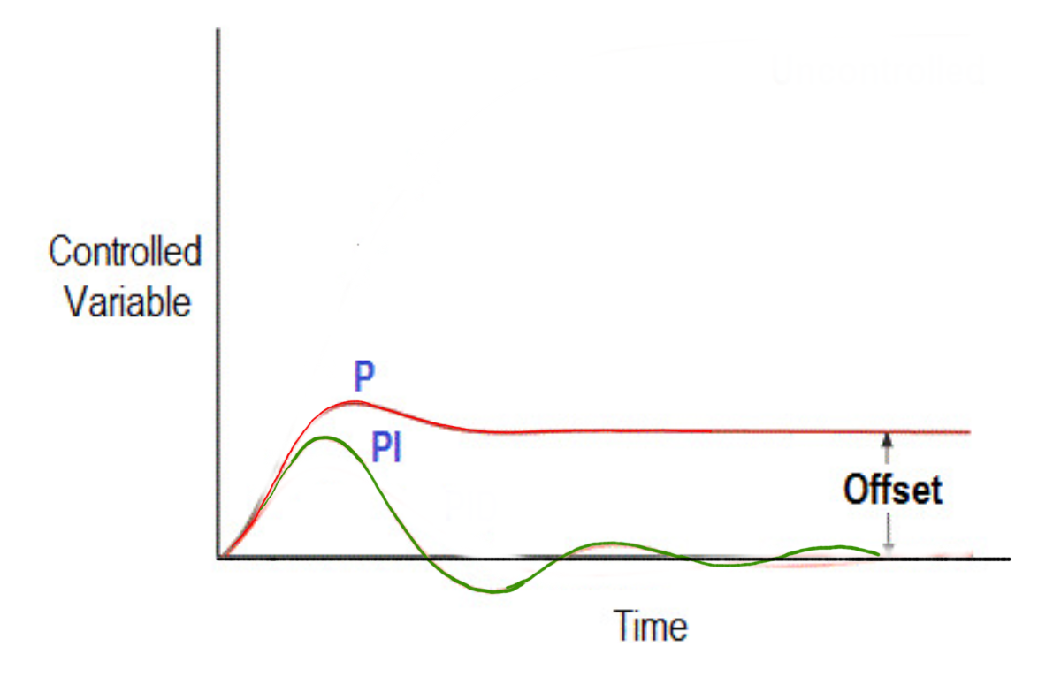
Desired Altitude
Ki*e + Kp * ∫e
Propeller
Actual Altitude
Altitude Measuring Sensor
50m

Slide 26
Ki*e +
Kp * ∫e + Kd * ∇ e
Actual Altitude
Desired Altitude
Propeller
Altitude Measuring Sensor
Propeller Speed = 10 * 10 = 100 rpm
Error = 10
50m
Output = Kp * error + Ki * (error1 + error2 + error3) + Kd * ( error3- error 2)

Slide 27
Ki*e +
Kp * ∫e + Kd * ∇ e
Actual Altitude
Desired Altitude
Propeller
Altitude Measuring Sensor
Propeller Speed = 10 * 10 = 100 rpm
Error = 10
50m
Output = Kp * error + Ki * (error1 + error2 + error3) + Kd * ( error3- error 2)
Proportional - Derivative - Integral Control
(PID) Control

Slide 28
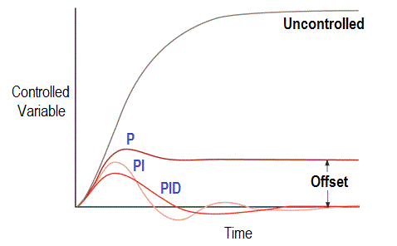
Proportional - Derivative - Integral Control
(PID) Control

Slide 29
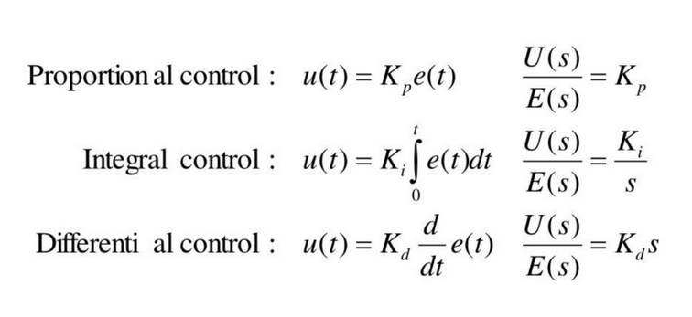
PID Controller

Slide 30
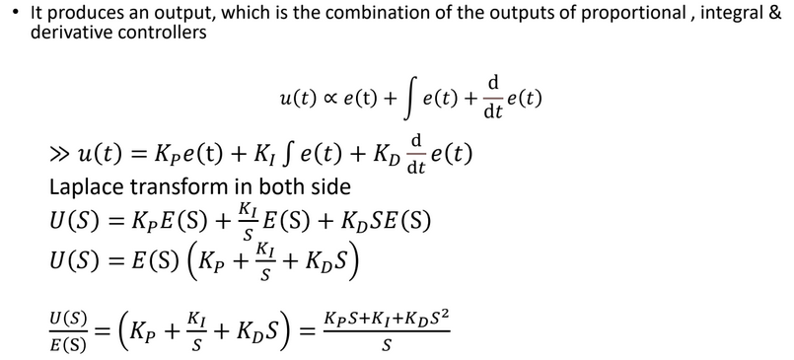

Slide 31
Effect of Controller Functions
• Proportional Action
Simplest Controller Function, The P term helps to reduce the steady-state error and improve the system's responsiveness. However, too high of a proportional gain can lead to instability and oscillations in the system's response.
• Integral Action
Eliminates steady-state error, The I term helps to improve the system's stability and eliminate any bias in the system. However, too high of an integral gain can lead to overshoot and instability in the system's response.
• Derivative Action (“rate control”)
Effective in transient periods, The D term helps to improve the system's stability and reduce the effects of disturbances in the system. However, too high of a derivative gain can lead to noise amplification and instability in the system's response.

Slide 32
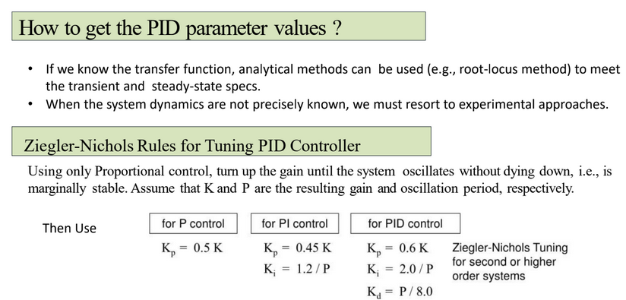

Slide 33
Generating PID parameters
Auto-Tuning Algorithms:
Relay-based Auto-Tuning
A relay is introduced in the control loop.
Observes the system's oscillatory response.
Calculates PID parameters based on oscillation characteristics.
Trial and Error: Iteratively adjust parameters based on system response.

Slide 34
Advantages and Applications of PID control
Advantages:
Simple: easy to understand.
Effective: Accurate and stable, even in dynamic environments.
Robust: Can be adopted to different robot systems
Application:
Arm positioning
Robot Navigation
Speed Control
Balance control

Slide 35
Next Class
Machine Learning

